Slide 1
Ada BoosT Algorithm

Slide 2
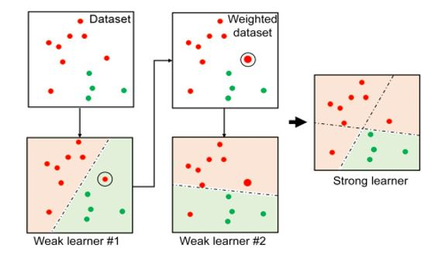

Slide 3
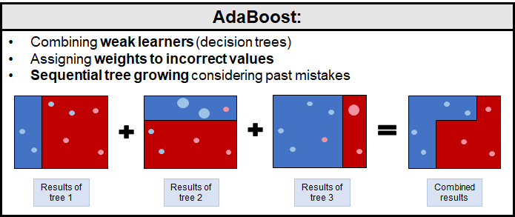

Slide 4
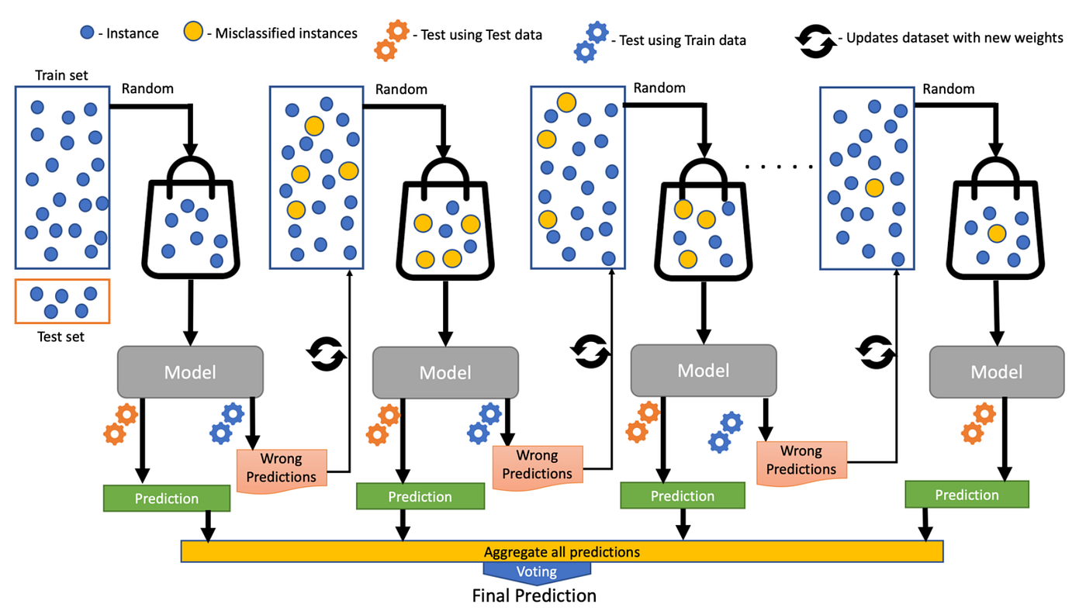

Slide 5
Ada Boost is a sequential process.
It creates lots of model and fits to the original dataset and gives additional copies on the same dataset. It takes the less error model compared to other models.
Ada Boost has one node and two leaves only and not a complete tree.
One tree is dependent on the previous trees. For example if we have multiple model (M1, M2, M3..) then M2 is dependent on M1 and M3 is dependent on M2.

